Slide 1
AUSTO PROJECT
COURSE TITLE: PYTHON FOUNDATIONS
DATE: JUNE 26TH, 2022

Slide 2
Contents
Business Problem Overview & solution approach
Data overview
Exploratory Data Analysis (EDA)
Business Insights and Recommendations

Slide 3
BUSINESS PROBLEM OVERVIEW & SOLUTION APPROACH
Austo, a UK-based automobile company aspires to grow its business into the US market after successfully establishing its footprints in the European market.
They want to understand the demand of the buyers and trends in the US market
They want to build customer profiles based on the analysis to identify new purchase opportunities so that they can manipulate the business strategy and production to meet certain demand levels.
To perform the data analysis to generate useful insights that will help the automobile company to grow its business.
To create buyer's profiles for different types of cars with the available data as well as a set of recommendations.

Slide 4
DATA OVERVIEW
Hatchback 884 Sedan 460 SUV 237
Hatchback 884 Sedan 460 SUV 237
NO | VARIABLE | DESCRIPTION
1 | Age | Age of the customer
2 | gender | Gender of the customer
3 | Profession | Indicates whether the customer is a salaried or business person
4 | Marital_status | Marital status of the customer
5 | Education | Refers to the highest level of education completed by the customer
6 | No_of_dependents | Number of dependents(partner/children/spouse) of the customer
7 | Personal_loan | Indicates whether the customer availed a personal loan or not
8 | House_loan | Indicates whether the customer availed house loan or not
9 | Partner_working | Indicates whether the customer's partner is working or not
10 | Salary | Annual Salary of the customer
11 | Partner_salary | Annual Salary of the customer's partner
12 | Total_salary | Annual household income (Salary + Partner_salary) of the customer's family
13 | Price | Price of the car
14 | Make | Car type (Hatchback/Sedan/SUV)
We have 1581 rows and 8 columns
We 8 objects and 6 integer
We converted all the object type to category which reduced the memory usage from 173kb to 87.6kb
The average age in the data is 32 years with max of 60 years
The average price for a car is 35,597
The average salary in the distribution is 59,732
The average total salary 79,452
The maximum number of dependents is 4
Some partners were not working which resulted to zero as the minimum partner salary and 80,000 as the maximum
We have three unique make of car
Hatchback - 884
Sedan - 460
SUV - 237

Slide 5
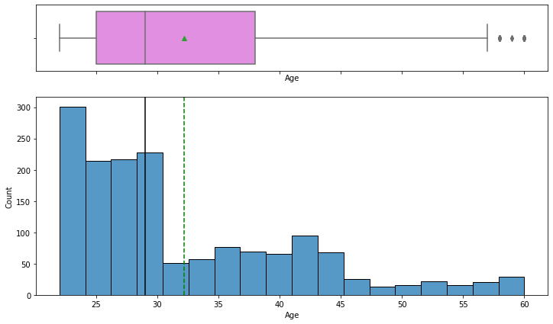
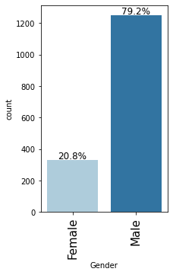
EXPLORATORY DATA ANALYSIS(EDA)
The average age of the distribution is higher than the median indicating the distribution is skewed to the right
The age bracket from 22 to 30 years are more likely to purchase a car
there are outliers in the distribution
The gender consist of two unique value male and female
The distribution shows a 79.2% male are more likely to buy a car and 20.8% are female

Slide 6
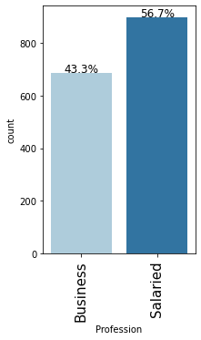
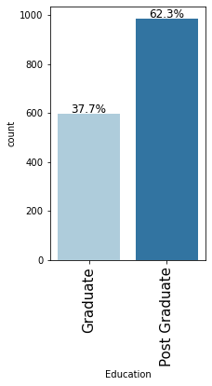
EXPLORATORY DATA ANALYSIS(EDA)
The chart shows two unique value in the profession for customers
There is a slight difference in the distribution, salary earned customers have an approximate of 57% and business owners 43%
Salary earners are more likely to buy a car
We have two unique value for education, graduate and post graduate
The distribution shows that 62.3% post graduate are interested in a car and 37.7% for graduate

Slide 7
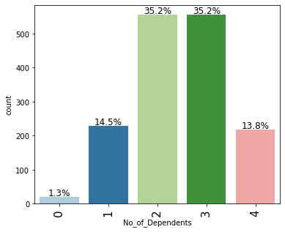
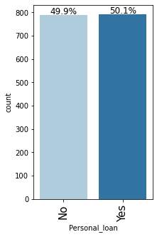
EXPLORATORY DATA ANALYSIS(EDA)
The chart shows people with 2 to 3 number of dependents are more like to buy a care compared to those with zero or four dependents
We have 35.2% for both 2 to 3 no of dependents , 14.5%, 13.8% for 1 and 4 no of dependents
People who have zero dependents have the lowest percentage 1.3%
The distribution shows slight difference in who has a personal loan and still wants a car
50.1% has person loan and 49.9% do not

Slide 8
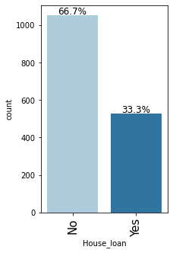
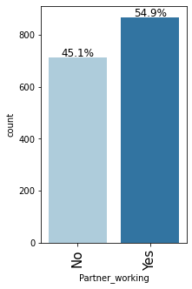
EXPLORATORY DATA ANALYSIS(EDA)
The distribution shows a difference in who has a house loan and still wants a car
66.7% has no house loan and 33.3 % do have house loan
The distribution shows slight difference in who has a partner working and still wants a car
45.1% do not have a partner working and 54.9% have partner working

Slide 9
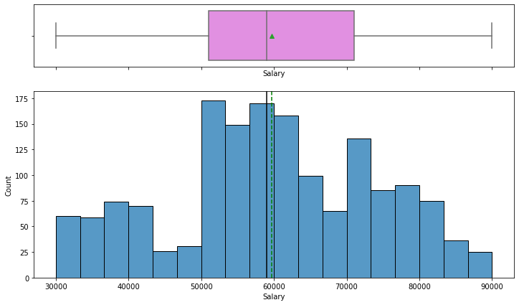
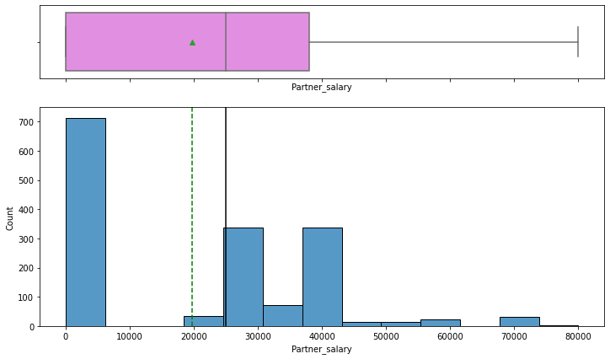
EXPLORATORY DATA ANALYSIS(EDA)
The average salary is almost the same with the median salary indicating the median is nearly symmetrical
There is not outlier in the distribution
The salary is almost evenly distributed between 30,000 to 90,000
The average partner salary is smaller than the median partner salary indicating the distribution is left skewed
There are no outlier in the distribution
The distribution shows average partner salary ranging around 20, 000

Slide 10
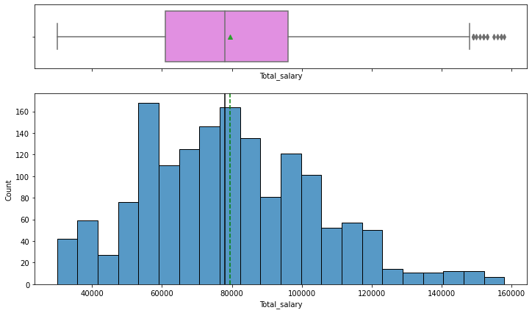
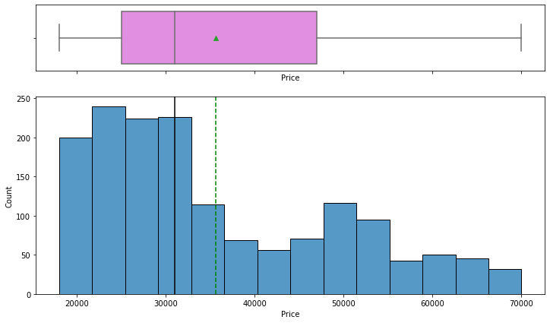
EXPLORATORY DATA ANALYSIS(EDA)
The average total salary is almost the same with the median total salary indicating the median is nearly symmetrical
The salary is almost evenly distributed between 40,000 to 160,000
There are outliers in the distribution
The average price of the distribution is higher than the median for price indicating the distribution is skewed to the right
This indicates that the price most likely to be paid for a car is 20,000 to 32,000
there are no outliers in the distribution

Slide 11
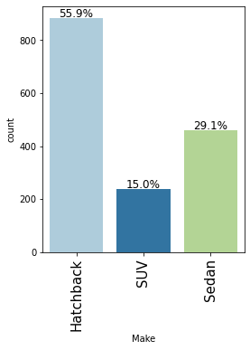
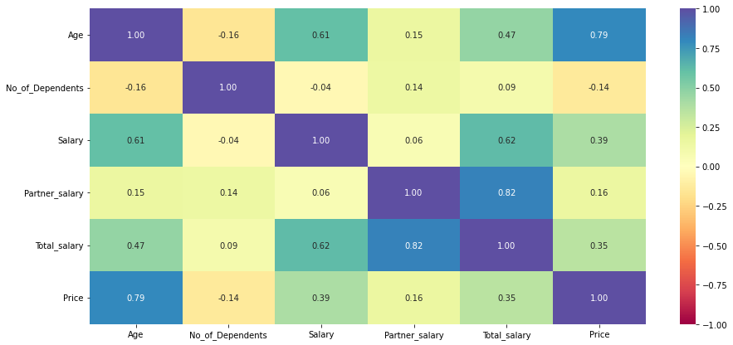
EXPLORATORY DATA ANALYSIS(EDA)
This map shows very little or no correlation between with no of dependents and the other variables
There is a strong correlation between the partner salary and total salary but little to no correlation with other variables
There is a positive correlation between age and price while very low correlation with the other variables
There is a positive correlation between salary, age and total salary compared to other variables
There is positive correlation between total salary, partner salary and salary compared to other variales
The chart shows three unique value in the car make for customers
55.9% are interested in hatchback which is the highest, 29.1% in sedan and the lowest SUV with 15%

Slide 12
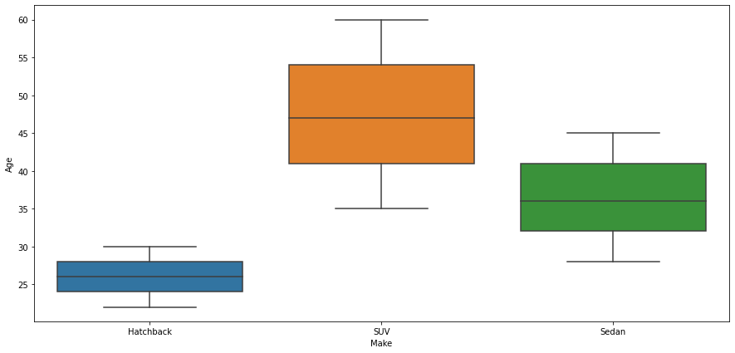
EXPLORATORY DATA ANALYSIS(EDA)
This chart shows the average age of 22 want hatchback maybe because its cheaper
Age bracket of s5 wants a sedan maybe because of the higher no of dependents as a family
The older customer want the SUV

Slide 13
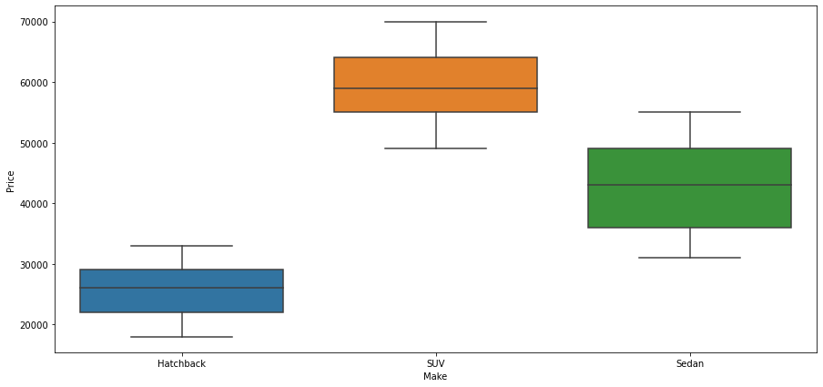
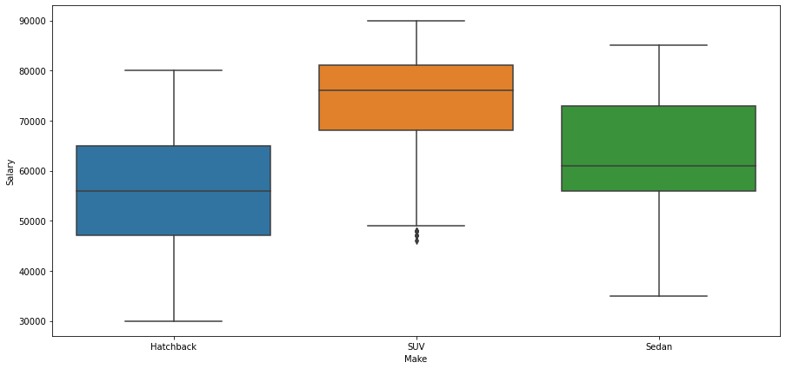
EXPLORATORY DATA ANALYSIS(EDA)
This distribution shows the SUV has a higher price range, followed by the sedan and the hatchback has the lowest
The relationship between the make of a car and salary shows that highest salary earners go for SUV
The salary earners between 50,000 to 60,000 go for hatch back and sedan

Slide 14
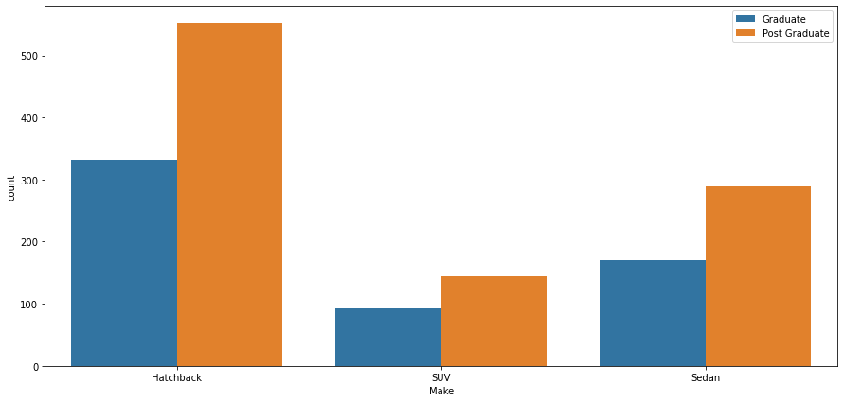
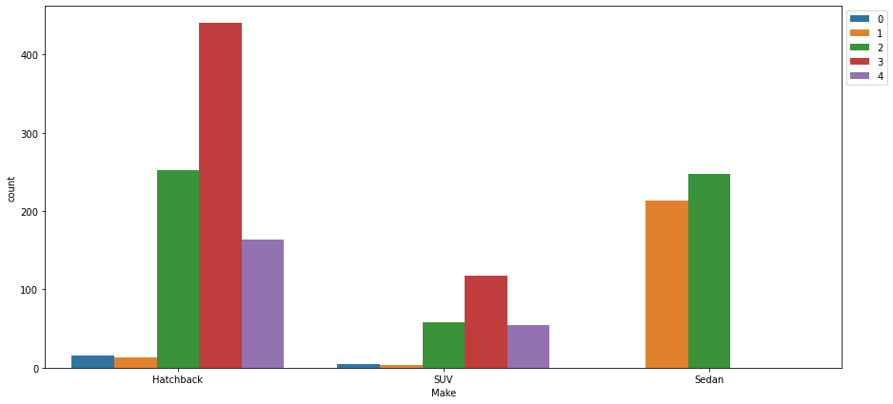
EXPLORATORY DATA ANALYSIS(EDA)
The distribution shows the postgraduate has the highest purchasing power for all the make of car
This distribution shows family with2 - 3 dependents will serves as customers for the hatchback

Slide 15
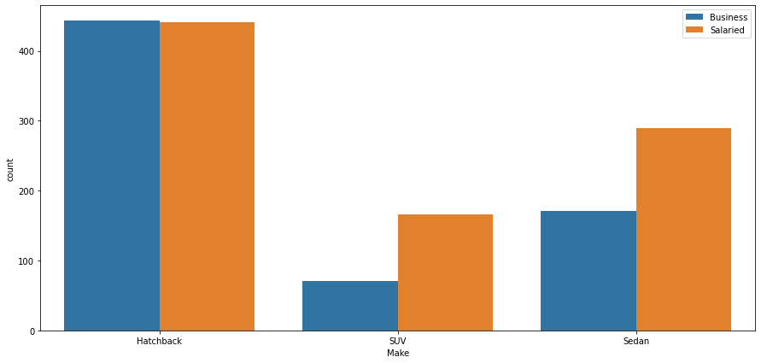
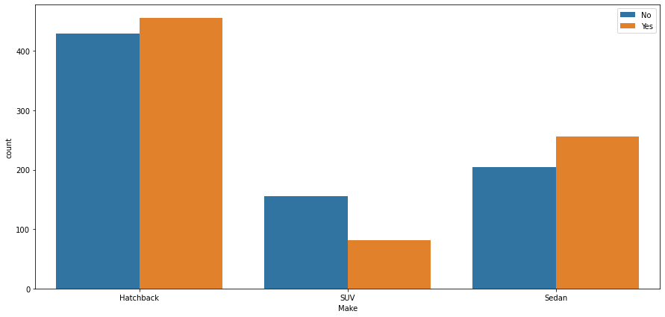
EXPLORATORY DATA ANALYSIS(EDA)
This distribution little difference between the profession for customers interested in hatchback with business owners higher
Salary earners have a higher percentage to buy the SUV or sedan
This distribution show more customers interested in the hatchback have personal loans
More customers interested in the SUV have no personal loan
More customers interested in the sedan have with personal loans

Slide 16
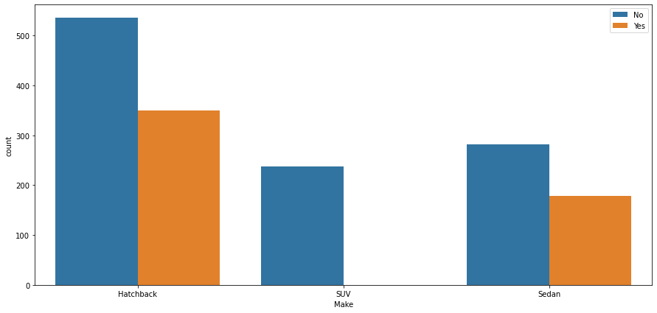
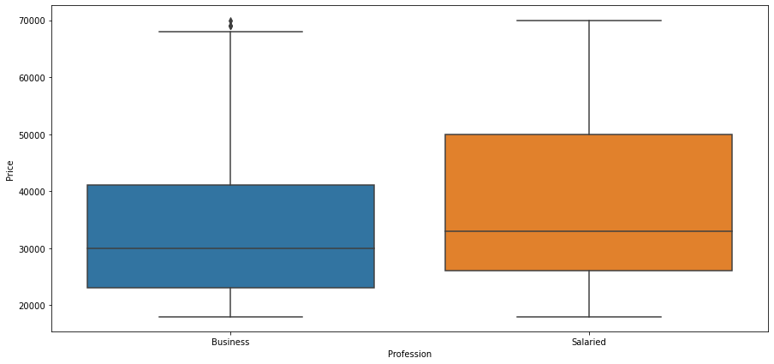
EXPLORATORY DATA ANALYSIS(EDA)
This distribution show more customers interested in the hatchback have no house loans
All the customers interested in the SUV have no house loan
More customers interested in the sedan have no house loans
This distribution shows salary earners have more interest in a car priced higher than business owners

Slide 17
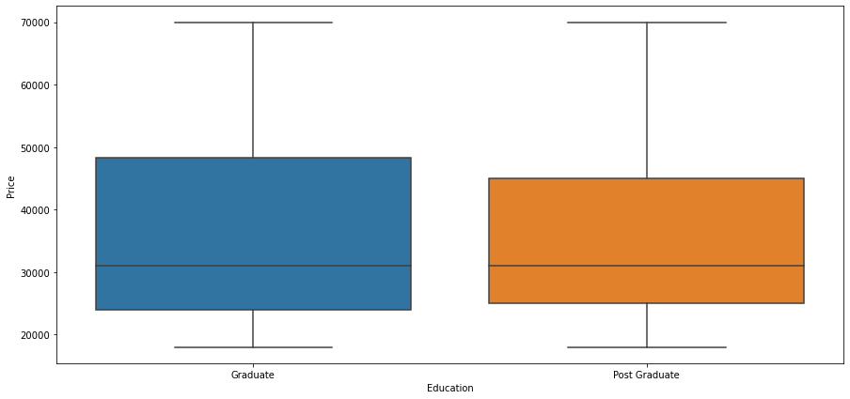
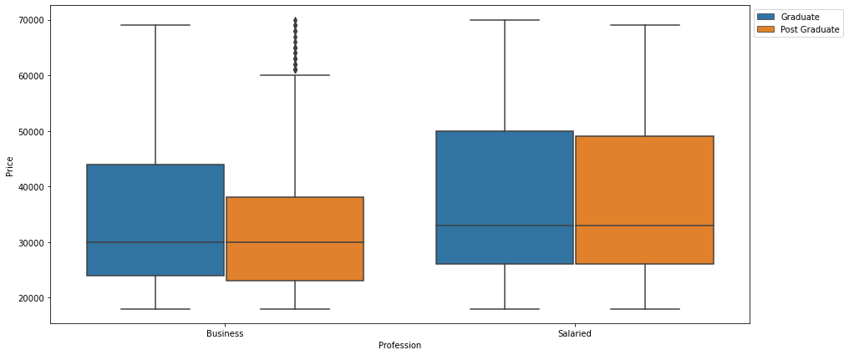
EXPLORATORY DATA ANALYSIS(EDA)
This distribution shows graduate go a slightly higher price of car
This distribution shows graduates would prefer a more expensive car

Slide 18
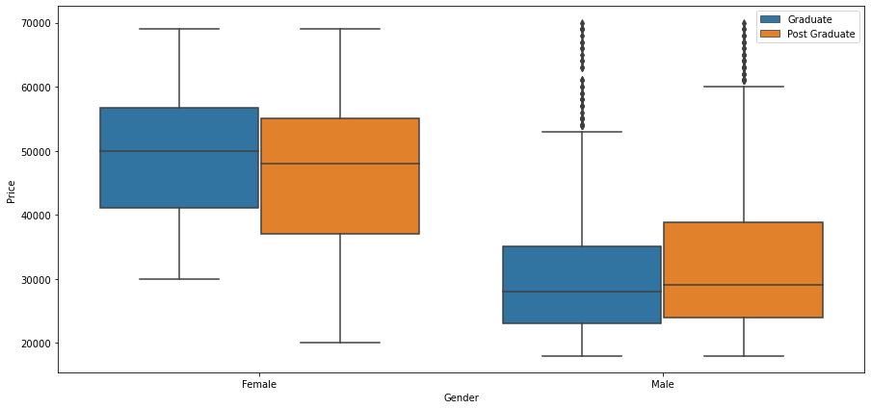
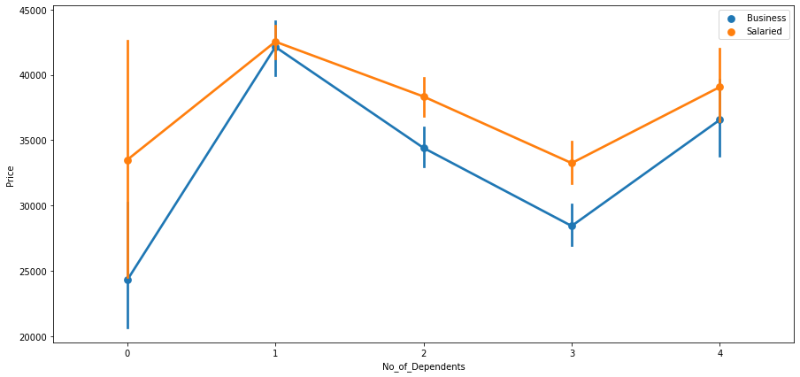
EXPLORATORY DATA ANALYSIS(EDA)
This distribution shows female graduates prefer a car on the higher price range than the post graduates
The male post graduates go for a higher car price compared to the graduate
This distribution shows both business and salaried with 1 dependents go for the car with the highest price range

Slide 19
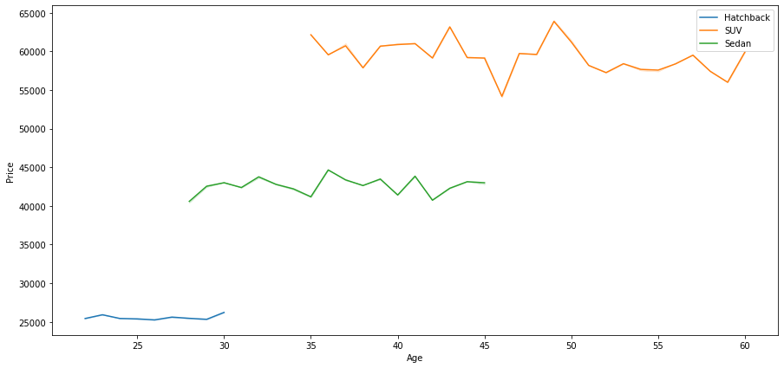
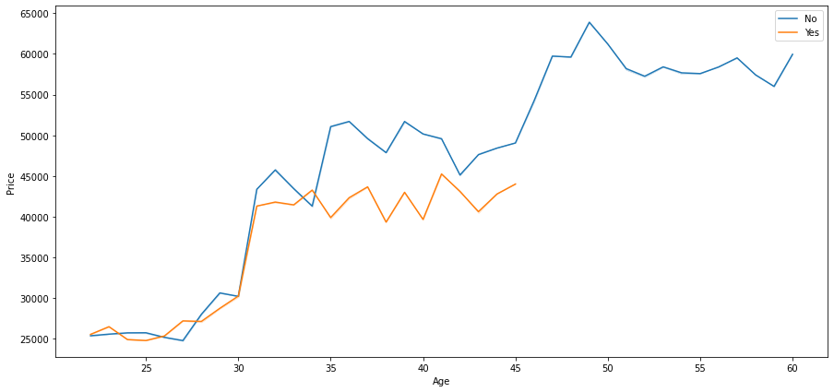
EXPLORATORY DATA ANALYSIS(EDA)
This distribution shows the older group prefer SUV which has the highest price range
The younger group prefer the hatchback and has the lowest price range
The mid age group select the sedan with the average price range
This chart shows the lower the age group the higher the chance of have a house loan
The older age group from 47-60 have no house loan

Slide 20
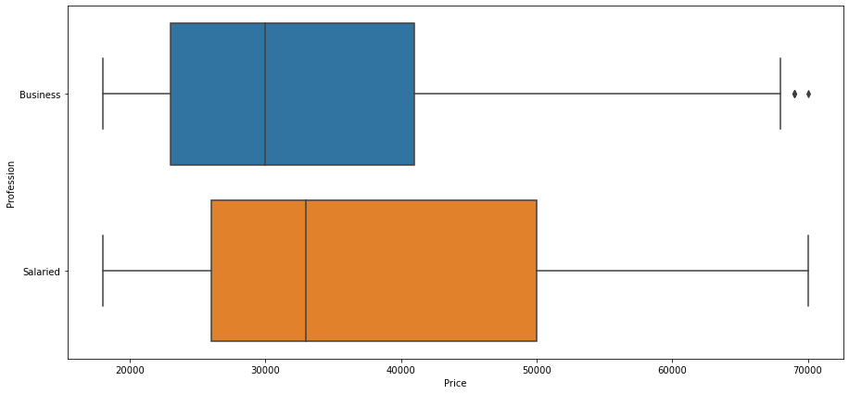
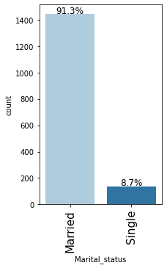
EXPLORATORY DATA ANALYSIS(EDA)
Business owners who have both house and personal loan have a lower price point compared to the salaried
We have two unique value for marital status, single and married
Married people has 91.3% in the chart, which show s a big difference in customers who are likely to buy a car, 8.7% for singles

Slide 21
BUSINESS INSIGHTS AND RECOMMENDATIONS
The following are the insights the data displayed
The distribution shows a 79.2% male are more likely to buy a car and 20.8% are female
Salaried customers of 57% have more interest in buying a car and business owners at 43%
62.3% post graduate are interested in a car and 37.7% for graduate
Customers with 2 to 3 number of dependents are more like to buy a car compared to those with zero or four dependents
50.1% of the customers has person loan and 49.9% do not
66.7% of the customers has no house loan and 33.3 % do have house loan
45.1% of the customers do not have a partner working and 54.9% have partner working
A big chunk 91.3% for married customers are likely to buy a car, 8.7% for singles
The following will be recommended for AUSTO;
Information from data shows females buy more expensive car, Austo should increase their number of female consumer as this can lead to more profits
I would recommend Austo increase the price of hatchback as the just 444 is priced above 25,000 and it has the highest request
Also, there is a huge market for singles missing, I would recommend Austo look into getting a car that would build interest in singles
Customers who have both person and house loan should have a price bracket for the car they want
The buyers profile for each make is below;

Slide 22
BUYERS PROFILE
MAKE | Age | Gender | Profession | Marital_ status | Education | No_of_ Dependents | Personal_ loan | House_ loan | Partner_ working | Salary | Partner_ salary | Total_ salary | Price
HATCHBACK | 25 | Male | Business | Married | Post Graduate | 3 | Yes | No | Yes | 54969 | 17707 | 72676 | 25561
SEDAN | 36 | Male | Salaried | Married | Post Graduate | 2 | Yes | No | Yes | 62213 | 20028 | 82241 | 42671
SUV | 47 | Male | Salaried | Married | Post Graduate | 2 | No | No | Yes | 72683 | 26632 | 99316 | 59303

